Slide 1

A pronoun is a word that takes the place of a noun.
Ex- Bob is swimming. He is swimming.

Slide 2

 | Singular | Plural
1st person | I | We
2nd person | You | You (all)
3rd person | He, She, It | They

Slide 3
 | Singular | Plural
1st person | I = Yo | We= Nosotros
2nd person | You= Tú | You (all)= Vosotros
3rd person | He, She, It= Él/ Ella | They=Ellos/ Ellas

Slide 4

Spanish subject pronouns are similar to English, but there are some differences.
 | Singular | Plural
1st person | I = Yo | We = nosotros (m) Nosotras (f)
2nd person | You (familiar) = tú | You (familiar) = vosotros vosotras
3rd person | He = él She = ella You (formal) = Usted | They (masculine) = Ellos They (femenine) = Ellas You all (formal) = Ustedes

Slide 5

Chico/Chica- boy/ girl
Chicos/ chicas- boys/ girls
Estudiante (s)- student ((aeiou) +s )
Inteligente- Intelligent
Alto/Alta- tall
Bajo/Baja- Short
Guapo/Guapa- handsome/ beautiful
Listo/lista- smart
Aburrido/aburrida- boring

Slide 6

Yo
Tú
Él
Ella
Usted
Nosotros/as + Ser
Vosotros/as
Ellos
Ellas
Ustedes

Slide 7

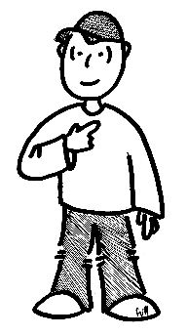
“Yo” means “I” and is used in the same way as in English.
  Yo soy chico/a
  Yo soy americano/a (American)
  Yo soy indio/ india
  Yo soy estudiante (student).
  Yo soy alto (tall)
  Yo soy listo (smart)
  Yo soy Amit

Slide 8

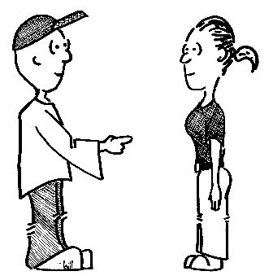
Tú means you (familiar/ informal)
Tú eres indio/india
Tú eres inteligente.
Tú eres estudiante.
Tú eres Jageshwar.

Slide 9

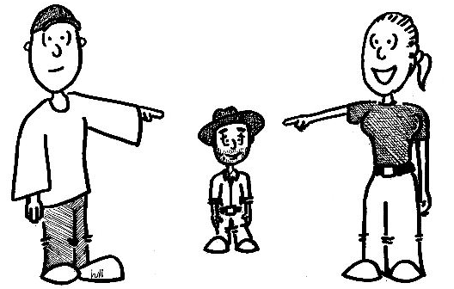
Él = he
It is used when talking ABOUT a boy/man.
used in the same way as its English counterpart:
  Jorge es mexicano. Él es de Guadalajara.
  Él es chico.
DON’T forget the accent mark. If you do, you are actually writing the Spanish word for “the”
  él = he el = the

Slide 10

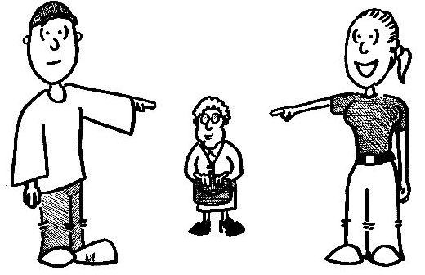
  Ella = she. Remember ll= y sound.
It is used when talking ABOUT a girl/woman.
used in the same way as its English counterpart:
  Rosa es mexicana.
  Ella es de Acapulco.
  Ella es baja.
  Ella es gorda
  Ella es chica

Slide 11

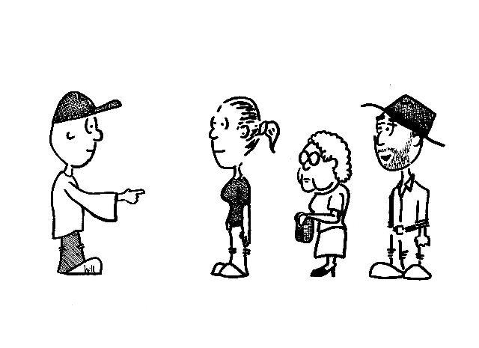
Usted means you (formal)
Used when talking to someone you should respect.
Abbreviated - Capital U lower case d period. (Ud.)
Considered a 3rd person singular pronoun for verb conjugation, but it is a 2nd person pronoun.
Usted es colombiana.
Usted es María.

Slide 12

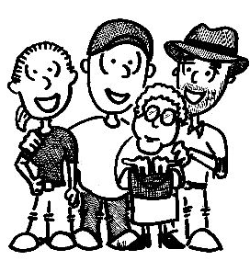
Use nosotros/nosotras to talk about a group of people that includes you.
In Spanish, we distinguish between “we” masculine and feminine:
    Nosotros somos guapos
    Sangeet y yo somos chicos.
    Maria y yo somos guapas
    (Abhishek y yo= nosotros)
    Yo y Abhishek
    Y= and

Slide 13

Vosotros/vosotras are the plural forms of tú.
Vosotros is used when talking to a familiar group of males or a mixed group.
Vosotras is used when talking to a familiar group of females.
Vosotros sois inteligentes.
Vosotros sois chicos.
Vosotras sois chicas.
Vosotras sois mexicanas.
(Atul y tú= Vosotros) sois indios.

Slide 14

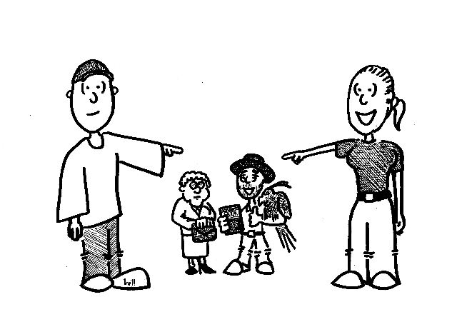
  Ellos = They (masculine) Remember ll= y sound.
It is used when talking ABOUT a group of boys/guys/men or a mixed group.
Ellos son mexicanos.
Ellos son inteligentes.
Pablo y Juan son colombianos.
Rahul y Ankita son estudiantes.

Slide 15


  Ellas = They (feminine), Remember ll= y sound.
It is used when talking ABOUT a group of only females.
Ellas son mexicanas
Ellas son guapas
Sukriti y Michelle son altas

Slide 16

Considered a 3rd person plural pronoun in verb conjugation but it is second person plural.
Ustedes (male or female)
Ustedes son peruanos
Ustedes son Maria y José.

Slide 17

In English, there is only one “YOU”. It is singular and plural, masculine and feminine, formal and informal
In Spanish there are 5 ways to express “you”
  tú
  usted (Ud.)
  vosotros
  vosotras
  ustedes (Uds.)

Slide 18
Yo soy
Nosotros somos
Nosotras somos
Ananya y yo somos
Anurag y yo somos
Tú eres
Vosotros sois
Vosotras Sois
Ananya y tú sois
Anurag y tú sois
Él es
Ella es
Usted es
Anything (singular) in third person
Mi familia es
Ellos son
Ananya y Anurag son
Ellas son
Ananya y Sukriti son
Ustedes son
Anything (plural) in third person
Mis padres son

Slide 19

Let’s look at the singular forms first. Each one has a specific time when it used. If you use the wrong one, it can be offensive to the person with whom you are speaking.
Tú = you (informal/familiar)
Use “tú” when talking to people with whom you are on a first name basis.
friends
family
small children
people younger than you
pets
Usted (Ud.) = you (formal)
Use “Usted” when talking with people to whom you should show respect.
People in authority (police, teachers, bosses, etc.)
Strangers
Acquaintances
Adults

Slide 20

In Spanish there are three ways to say “all of you”
  Vosotros
  Vosotras
  Ustedes (Uds.)
Vosotros/vosotras are the plural forms of tú. Ustedes is the plural form of usted.
Vosotros is used when talking to a familiar group of males or a mixed group.
Vosotras is the feminine form of vosotros and is used when the entire group is female
These two familiar forms are used primarily in Spain.

Slide 21
The plural you form “ustedes (Uds.)” Is used differently in Spain and Latin America.
In Spain, vosotros/as is used when talking to an informal group. Uds. is used to address a formal group.
In Latin America, Uds. is generally used in both formal and informal situations. (They don’t use vosotros/as)

Slide 22
Yo = I
First person singular
Not capitalized unless the first word of the sentence
Used to talk ABOUT yourself
Nosotros/as = we
First person plural
distinguish between “we” masculine and feminine
Used to talk ABOUT yourself and friends
Tú = You (singular, informal/familiar)
Second person Singular
Use it to talk TO a person that is a friend or family member
Vosotros/as = You (singular, familiar)
Second person Plural
Use it to talk TO a group of friends or family members.
Third person singular
Él = he
Don’t forget the accent
Use it to talk ABOUT a guy.
Third person plural
Ellos = They (masculine)
It is used when talking ABOUT a group of boys/guys/men or a mixed group.
Ellas = They (feminine)
It is used when talking ABOUT a group of only females.
Uds. = You (plural)
Use it to talk TO a group of people
Ella = she
Use it to talk ABOUT a girl.
Watch the pronunciation.
Ud. = You (singular, formal)
Use it to talk TO a person that is due respect.

